Slide 1


SCALING UP THE MHBS/DHIS2
TRACKER AND TRAINER APPLICATIONS
LibreHealth

Slide 2

LibreHealth (https://librehealth.io)
#LibreHealth is an umbrella organization(collaborative community) where multiple health information technology projects collaborate.
#The mission of LibreHealth is to help provide high quality medical care to all people, regardless of race, socioeconomic status, or geographic location, by providing medical practices and clinics across the globe access to free of charge medical software.

Slide 3
01
02
LIBRE HEALTH EHR APPLICATION
is a clinically focused electronic health record(EHR) system , which is easy to use and also customizable for use in a variety of health care settings
LIBRE HEALTH
TOOL KIT
is a software that serves as an foundational API and also is a data model for foundational applications (is a powerful REST API)
TRENDING WORKS OF LIBRE HEALTH ORGANIZATION

Slide 4
03
LIBREHEALTH RADIOLOGY
is an open source radiology information system , it manages the clinical workflow of radiology department , using DECOM (International standard to transmit, store, retrieve, print, process, and display medical imaging information)
TRENDING WORKS OF LIBRE HEALTH ORGANIZATION
**THE MAJOR TECHNOLOGIES USED ARE ANDROID,JAVA,JAVASCRIPT, PYTHON AND PHP**

Slide 5
Coming Back to GSOC 2020
The libre Health Organization also came up with a similar problem in the year 2020 , wherein the task was to develop an android application to show birth registration and newborn health data
The tasks done were:
1)Designed the UI of the guardian app using figma.
2) Developed a native android application for the guardian using Java and Kotlin.
3) Implemented DEMO mode in guardian app with dummy credentials.
4) Implementing(WIP) LIVE mode by integrating Evernym mobile SDK into the guardian app.
5) Created a Informant app using Flutter, which in future can be used to give credentials to the Guardian app.
The details are available in the below link : Android application to show birth registration and newborn health data - 2020 - Google Summer of Code Archive

Slide 6
DEVELOPING AN ANDROID APPLICATION FOR NEW BORN CLINICAL DECISION SUPPORT
# ECEB(essential care for every baby) is an educational and training program , developed by American academy of pediatrics , provides knowledge, skills, and competencies to nurses and doctors in low/middle-income countries so that they can provide life-saving care to newborns from birth through 24 hours postnatal(period after childbirth).
#The aim of this project is to develop an android mobile application , the ECEB digital action plan , that is purposely built to provide clinical decision-support for nurses and doctors delivering essential newborn care interventions(actions) during first day of life

Slide 7
FEATURES OF ECEB ANDROID APPLICATION
1. Time-stamping(recording time and date) births to generate an essential newborn care clock for babies.
2. ability to track multiple babies at a time
3. automated classification of babies health status , based on results from observations and assessments
4. automated advice on management of babies , based on their classification
5. reminders/alerts to provide recommended essential newborn care interventions
6. if particular interventions are not delivered on time , then capture information regarding why this essential newborn care was late or missed

Slide 8
MHBS/DHIS2 TRACKER AND TRAINER
#DHIS 2 - global public good transforming health information management around the world , developed by HISP(health information system program)
#DHIS2 has a modular, layered architecture with a strong and open application programming interface (API).
#It stores information from various sources , stored in dhis2 database and can be used to analyze the situation
#Also has an offline feature , that is sending SMS .
#Can be used in less internet areas also

Slide 9
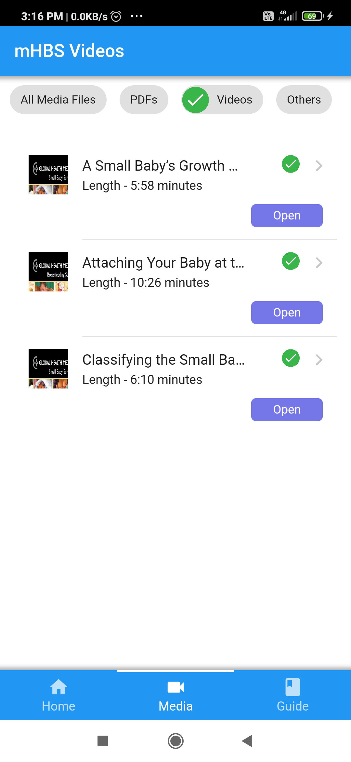
TRAINER APP
TECH :
# Cordova(html,css,javascript) , xml , framework7(free and open source HTML mobile framework to develop hybrid mobile apps or web apps with iOS or Android)
#Training for neonatal resuscitation through videos, guide and other kind of training material
FEATURES :
#Offline support and sync facility (using SQL)
#Uploading resources and accessing
#App usage tracking system (SQL)

Slide 10
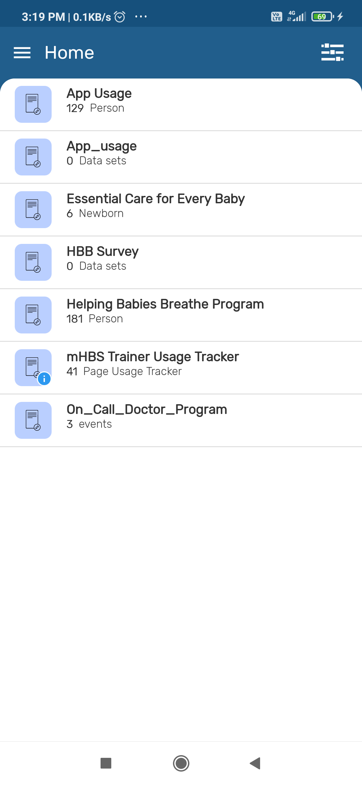
TRACKER APP
TECH :
Kotlin , Java , Python , Shell(interactive command and scripting language) , HTML ,Gradle(to build software's)
FEATURES :
#MHBS Tracker app is used to collect data from the dhis2 mobile application
#It tracks the health status of the baby in the early days of his birth.
#App usage tracker, offline support

Slide 11
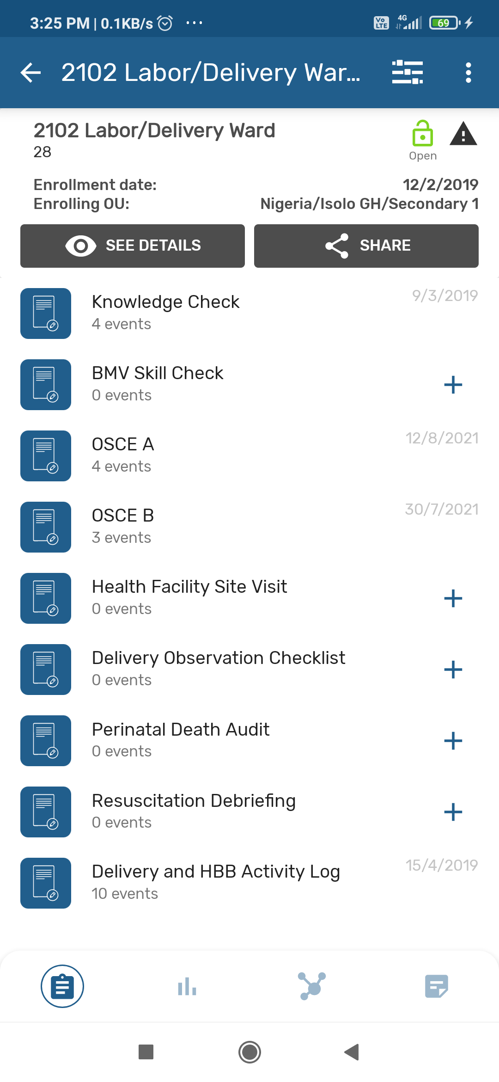
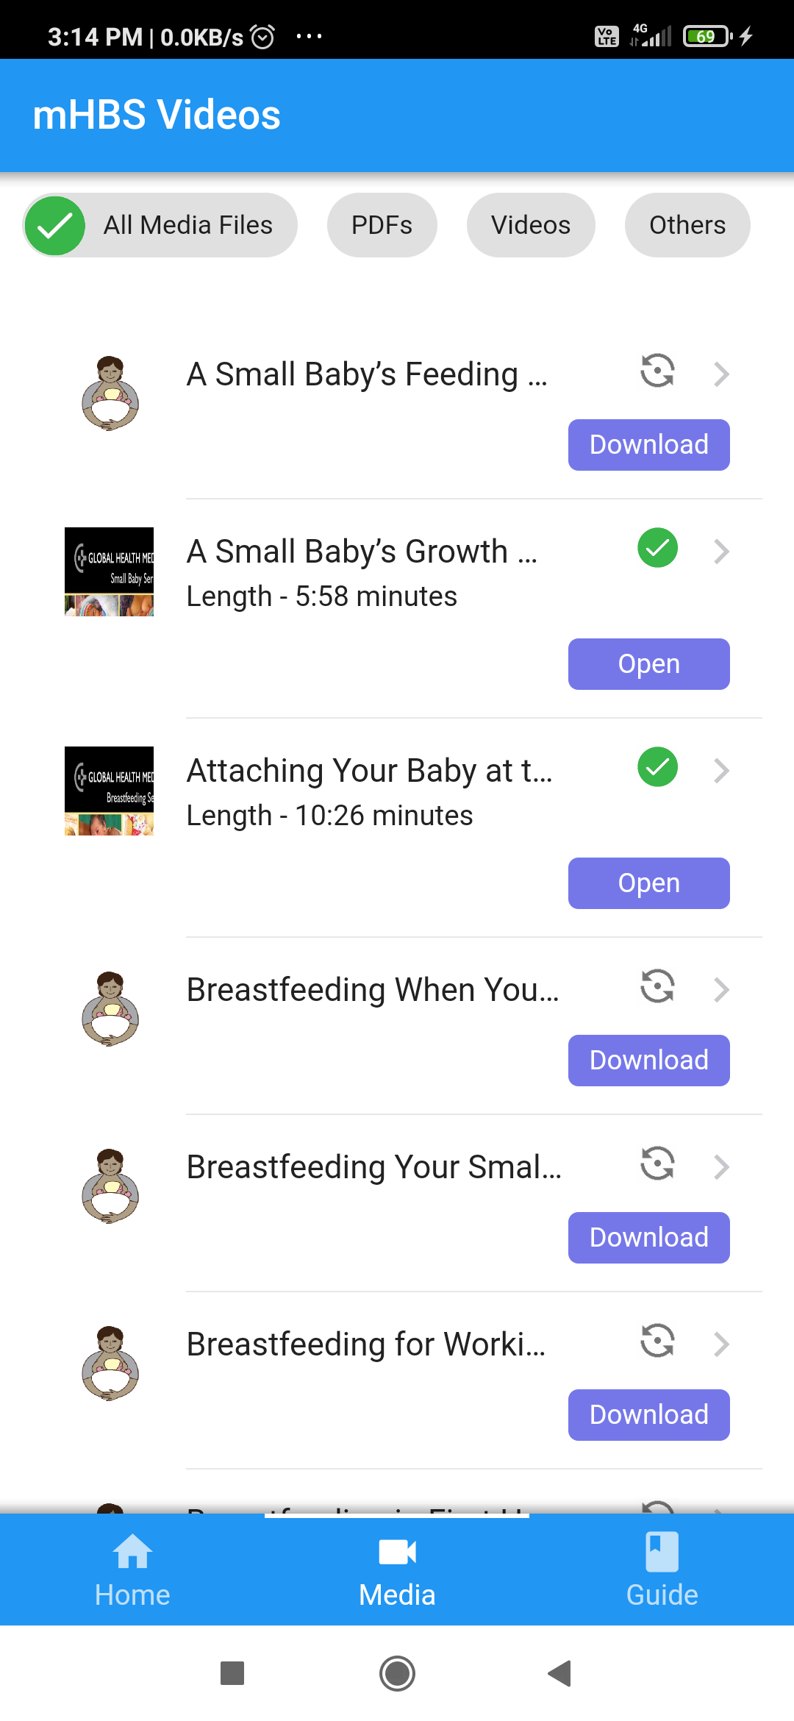
PROJECT 1
TRAINER APP
Mercury is the closest planet to the Sun and the smallest one in the Solar System. This planet's name has nothing to do with the liquid metal, since Mercury was named after the Roman messenger god
TRACKER APP

Slide 12
Works To be Done:
Update mHBS-Tracker & Set-up CI/CD
Merged the upstream changes that have more than 6K unmerged commits.
Modified the final merged code to have features and look like the mHBS app.
App Name and Logo has been changed.
UI Improvements.
Added External other apps of mHBS to the app drawer.
Added functionality to open other mHBS apps.
Set up CI/CD to automatically build the app and check for errors.
Fixed Some of the build errors
Added Media Page | Added Feature to play any type of media file | Set-up CI Pipeline :
Added Media Page in trainer app and uploaded some educational & testing resources on dhis2.
Integrated API Calls to fetch media resources into trainer app.
Integrated cordova-file-opener2 plugin and make all types of media files accessible through the app.
Integrated Gitlab CI Pipeline to automatically build the apk.

Slide 13
Added offline support :
Implemented File sync feature and added appropriate synced icon for stages.
Implemented sqlite-database and cordova file plugin to storage purpose.
Added full offline support for synced media files.
Sync facility is added for both the list of documents and for document media files as well.
Added System to track app usage :
App usages are being stored locally in the SQL database ( like Page visits, Time spent, etc.).
After crossing the min. threshold limit app usage will get synced with the dhis2 user’s datastore and shifted to dhis2.
Overall usage of each page (approx 15+ pages) can be tracked remotely over dhis2 and can be used for analytical purposes.

Slide 14
UI Improvements & Filtering Options :
Added filtering options for media files to sort them in categories by their types.
Improve UI, added button.
Added Thumbnail and video duration in media files.
Passed user credentials to trainer app :
Shared login credentials of tracker app with the trainer app.
There is a single login in the tracker app and all the other connected apps will use that credentials for further process, users needs not to logged in again and again in all mhbs apps.

Slide 15
THANK YOU,
Any Questions?

